Slide 2

Jeremiah 14:10-16

Slide 3
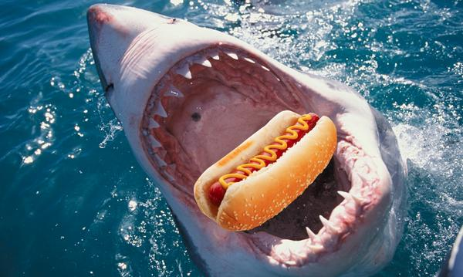
Sharks notorious for swallowing just about anything!

Slide 4

Sea hedgehog or urchin fish

Slide 5
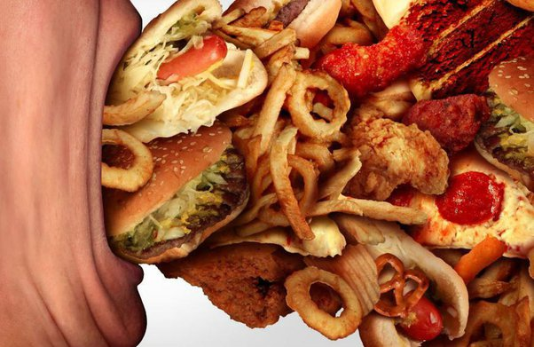
People Much Like Sharks….
Swallowing Any Idea That Comes Along!

Slide 6
We hear them say:
“A Prophet Told Me….”
Deuteronomy 13:1-5
True Prophet Is Always Correct When Speaking Of The Future- Deuteronomy 18:20-22
Prophecy (miraculous) Has Ended – 1 Corinthians 13:8-10
Some Prefer Lies – Jeremiah 5:31
Don’t Believe A Prophet Who Doesn’t Come From God – Jeremiah 29:8,9

Slide 7
We hear them say:
“The Preacher Told Me….”
2 Peter 2:1 “there will be false teachers among you”
Before destruction of Jerusalem…false teachers- Matthew 24:4,5
We are NOT to believe all we hear – 1 John 4:1
Satan / Followers disguised – 2 Corinthians 11:12-15
Check what they SAY – Acts 17:11
Check how they ACT – Matthew 7:15-20

Slide 8
We hear them say:
“I read a book that said….”
Colossians 2:4 “persuasive words.”
Empty Words- 2 Peter 2:18
Promote Themselves – Romans 16:18
Tossed to and fro – Ephesians 4:14
Anything “different” not accepted – Galatians 1:6-9

Slide 9
DO YOU SWALLOW ANYTHING THAT COMES ALONG?
Proverbs 14:15 “simple believes every word”
1 Corinthians 5:12,13 “put away from yourselves the evil person."
Don’t Tolerate False Teaching – 2 Corinthians 11:3,4

